Slide 1
Project – Search Algorithm for 8 – Puzzle Problem Solving
Team A
Team Members:
- Ratul Mazumder
- Sai Venkata Ramana Sampath Kothuri
- Roshani Jha

Slide 2
What is the 8-Puzzle Problem?
The 8-puzzle is a classic combinatorial problem played on a 3x3 grid.
It consists of 8 numbered tiles and 1 blank space, where the goal is to rearrange the tiles to match a given target configuration.
Moves are made by sliding tiles into the blank space (up, down, left, right).
The problem is an example of a state-space search, where we explore different configurations (states) to find the solution.
Example configurations:
- Initial state
- Goal state

Slide 3
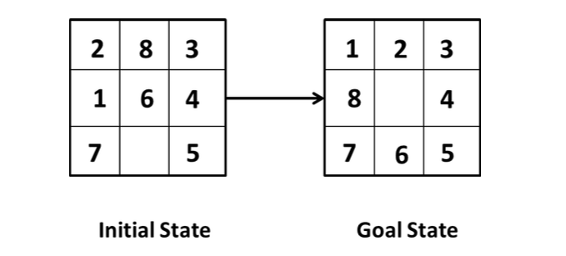
Given an initial state of the 8-puzzle problem and a final state to be achieved.
Example :

Slide 4
Why is the 8-Puzzle Problem important?
Algorithmic Learning: Provides a foundational problem for understanding search algorithms like A*, BFS, DFS, etc.
Heuristic Optimization: Demonstrates the use of heuristics to guide search processes efficiently.
Artificial Intelligence: Serves as a benchmark for testing AI techniques in solving complex problems.
Problem-Solving Skills: Encourages logical reasoning, strategic planning, and computational thinking.
Historical Significance: Originated from the 15-puzzle (1870s) and became a widely studied problem in computer science and AI.

Slide 5
Analogies to the 8-Puzzle Problem in Real Life
Navigation Systems: Finding the shortest route between two points using heuristic-based pathfinding (e.g., Google Maps).
Resource Scheduling: Allocating limited resources (e.g., CPU scheduling or task assignment).
Logistics Optimization: Rearranging containers in a warehouse or shipyard to reach a desired order efficiently.
Game Design: Many puzzles and strategy games involve similar state-space exploration principles (e.g., Sudoku, Rubik's Cube).
Robotics: Path planning for robots moving in constrained environments.

Slide 6
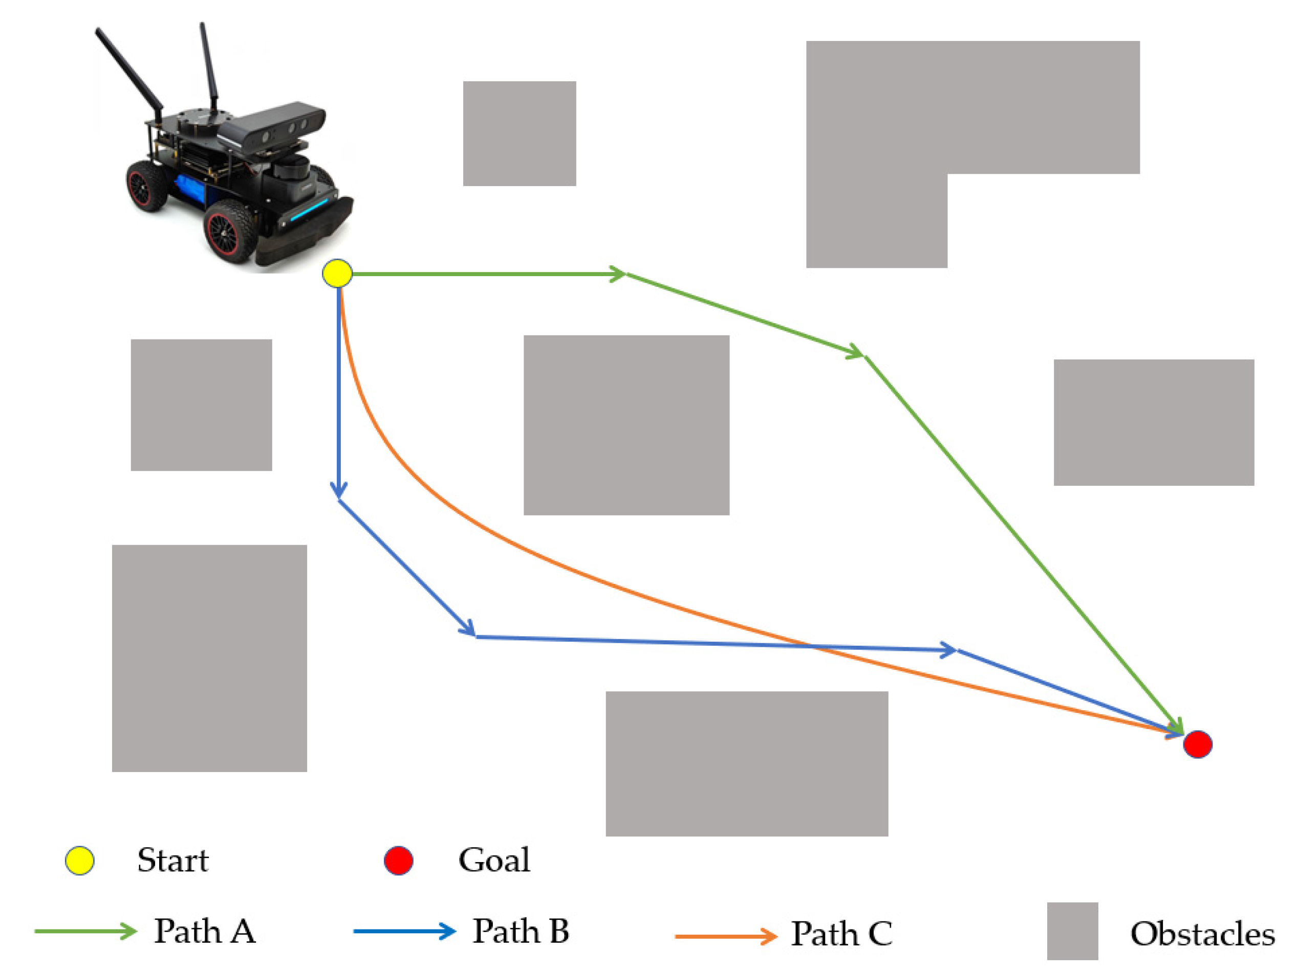
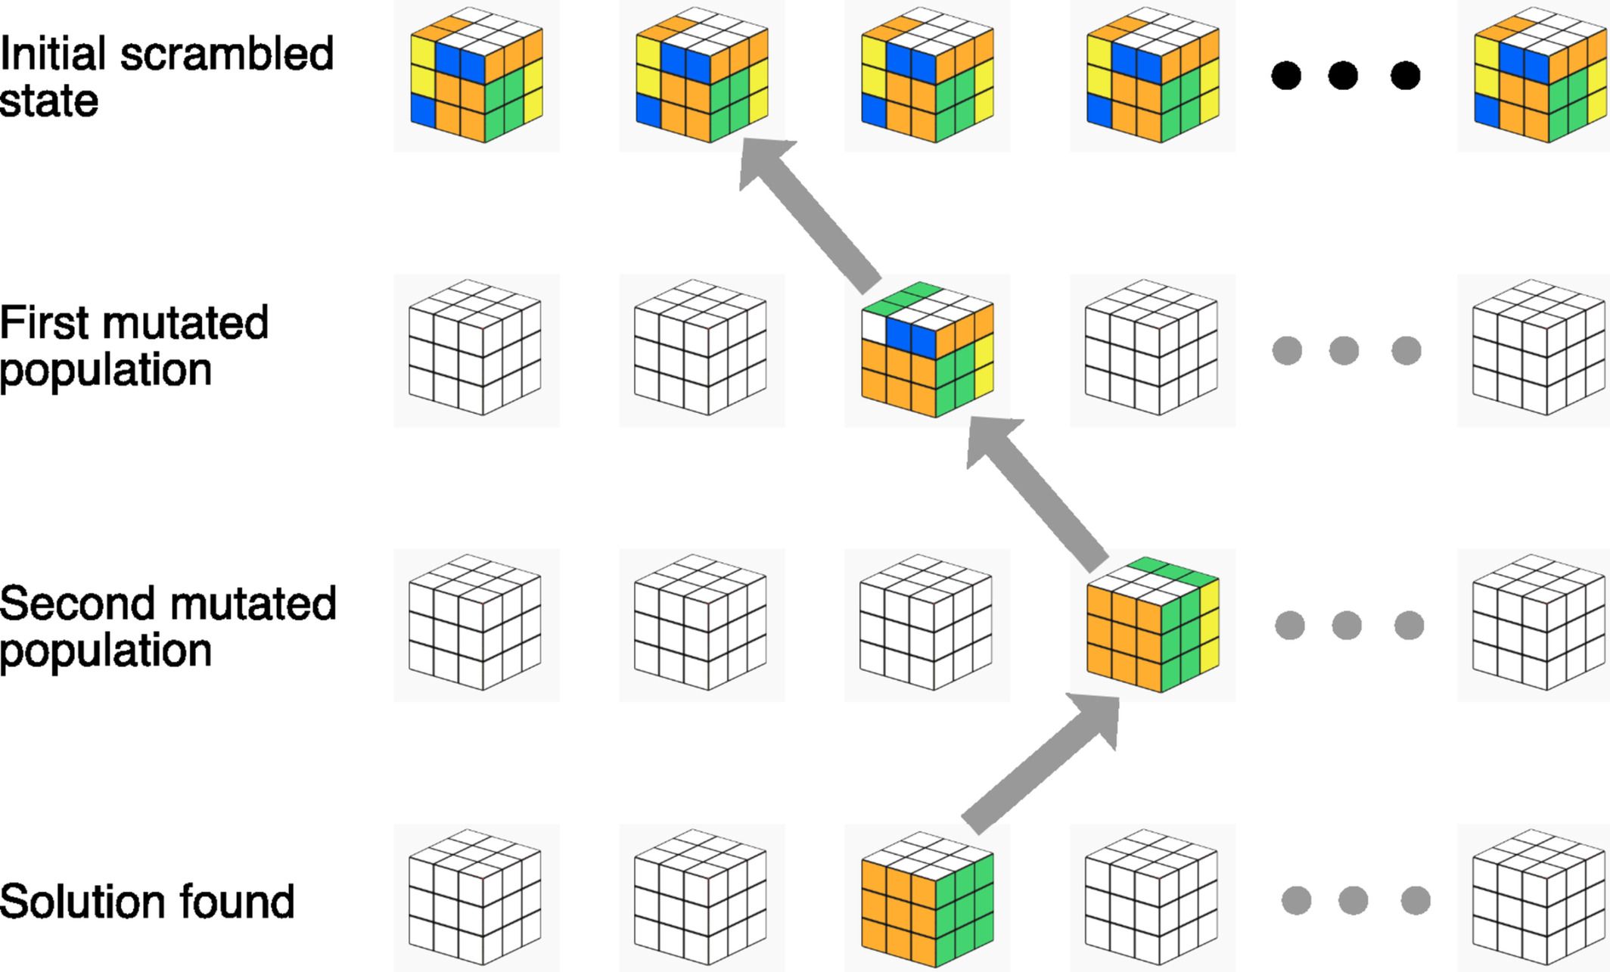

Slide 7
Literature Review
Jananji, S. D. T., and D. D. A. Gamini. "Measuring Heuristic Accuracy on the Performance of Search Algorithms in Solving 8-Puzzle Problems." Vidyalaya Journal of Science 27.01 (2024).
This paper examines the role of heuristic accuracy in the performance of search algorithms for the 8-puzzle, demonstrating that heuristics like the Manhattan distance can reduce nodes expanded by over 99% and improve both time and space complexity significantly. The study confirms that the Manhattan heuristic achieves a lower effective branching factor, leading to faster, more resource-efficient solutions.
Mishra, Arpan Kumar, and P. C. Siddalingaswamy. "Analysis of tree-based search techniques for solving 8-puzzle problem." 2017 Innovations in Power and Advanced Computing Technologies (i-PACT). IEEE, 2017.
The authors analyze tree-based search techniques such as BFS, DFS, and A* for the 8-puzzle problem, showing that A* consistently finds optimal solutions more efficiently than uninformed methods. Their results indicate that, while BFS guarantees the shortest path, it requires extensive memory, whereas A* uses heuristics like Manhattan distance to balance optimality with reduced memory and time demands.
Mathew, Kuruvilla, and Mujahid Tabassum. "Experimental comparison of uninformed and heuristic AI algorithms for N Puzzle and 8 Queen puzzle solution." Int. J. Dig. Inf. Wireless Commun.(IJDIWC) 4.1 (2014): 143-154.
This study provides an experimental comparison of uninformed and heuristic search algorithms, including BFS, DFS, and A*, applied to the N-Puzzle and 8-Queen problems. It concludes that A* with an appropriate heuristic (such as Manhattan distance) significantly outperforms uninformed searches in terms of efficiency and solution quality, particularly for larger puzzle sizes, by effectively reducing the search space and focusing on promising paths.

Slide 8

BFS and A* Algorithm: An Overview
Breadth-First Search (BFS)
BFS is an uninformed search algorithm.
It explores nodes level by level, guaranteeing an optimal solution.
BFS is memory-intensive as it explores all possibilities.
A* Algorithm
A* is an informed search algorithm.
It combines actual cost (g(n)) and heuristic estimate (h(n)).
A* uses heuristics like Manhattan distance or Euclidean distance.
Efficiently focus on promising paths.

Slide 9
BFS in Action: Solving the 8-Puzzle
Initial Configuration
BFS starts at the initial puzzle state. It explores all possible moves systematically.
Level-by-Level Exploration
All neighboring states are examined before moving to the next level. This ensures thoroughness.
Goal State Check
Each explored state is compared to the goal configuration. BFS continues until a match is found.
Solution Found
BFS guarantees the shortest path but may be slower for complex puzzles. It stores all explored nodes.

Slide 10
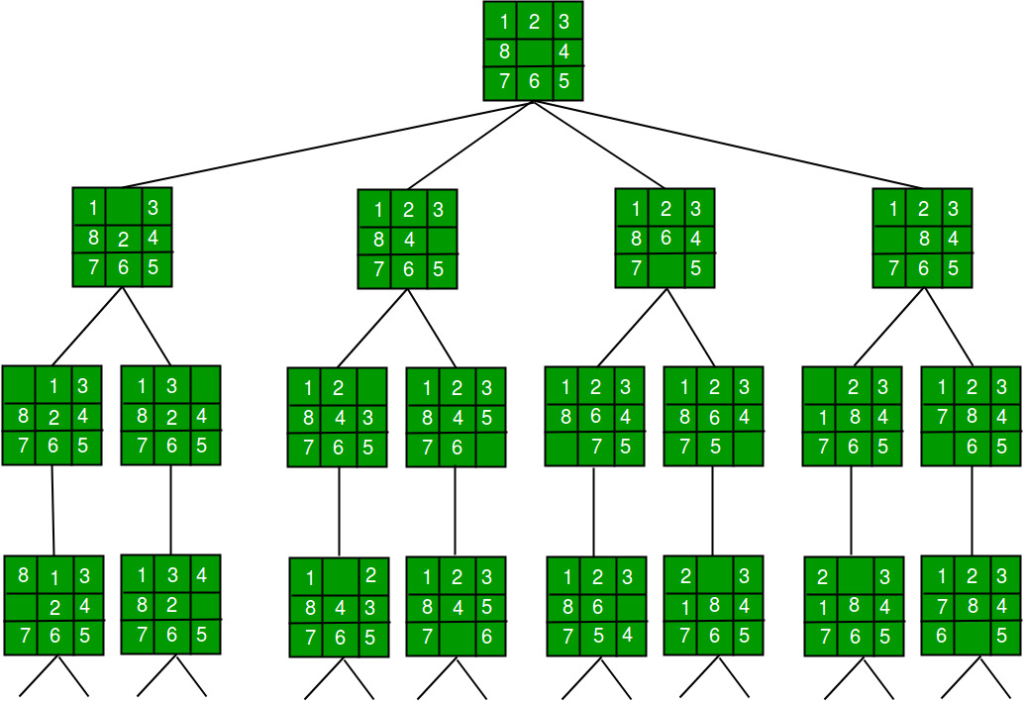
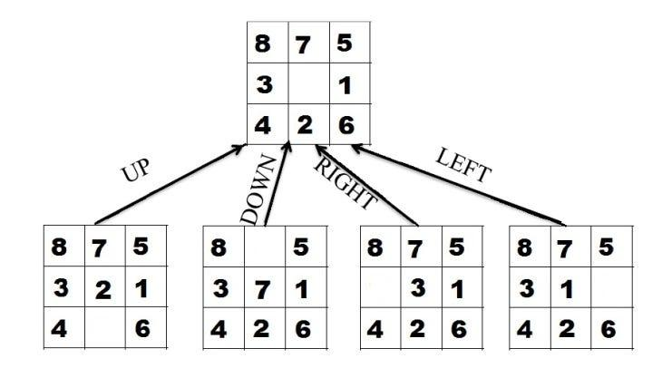
8-puzzle work with BFS:

Slide 11
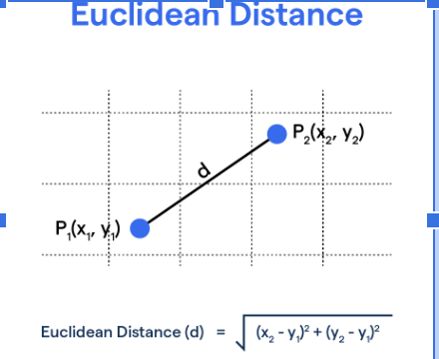
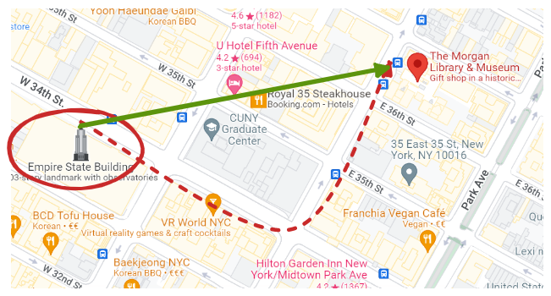
Heuristics and A* Algorithm
Manhattan Distance
Heuristics: Heuristics estimate the cost to reach the goal. They help prioritize promising states, reducing unnecessary exploration in search algorithms.
A* Implementation: A* uses f(n) = g(n) + h(n) to guide the search. It expands nodes with the lowest f(n) value.
Euclidean Heuristic: Used to calculate straight-line distances. It's less suitable for the 8-puzzle due to irrelevant diagonal movements.
Manhattan Heuristic: Used for calculating the sum of absolute differences (Horizontal & Vertical) in tile positions. It matches puzzle constraints and is computationally efficient.

Slide 12
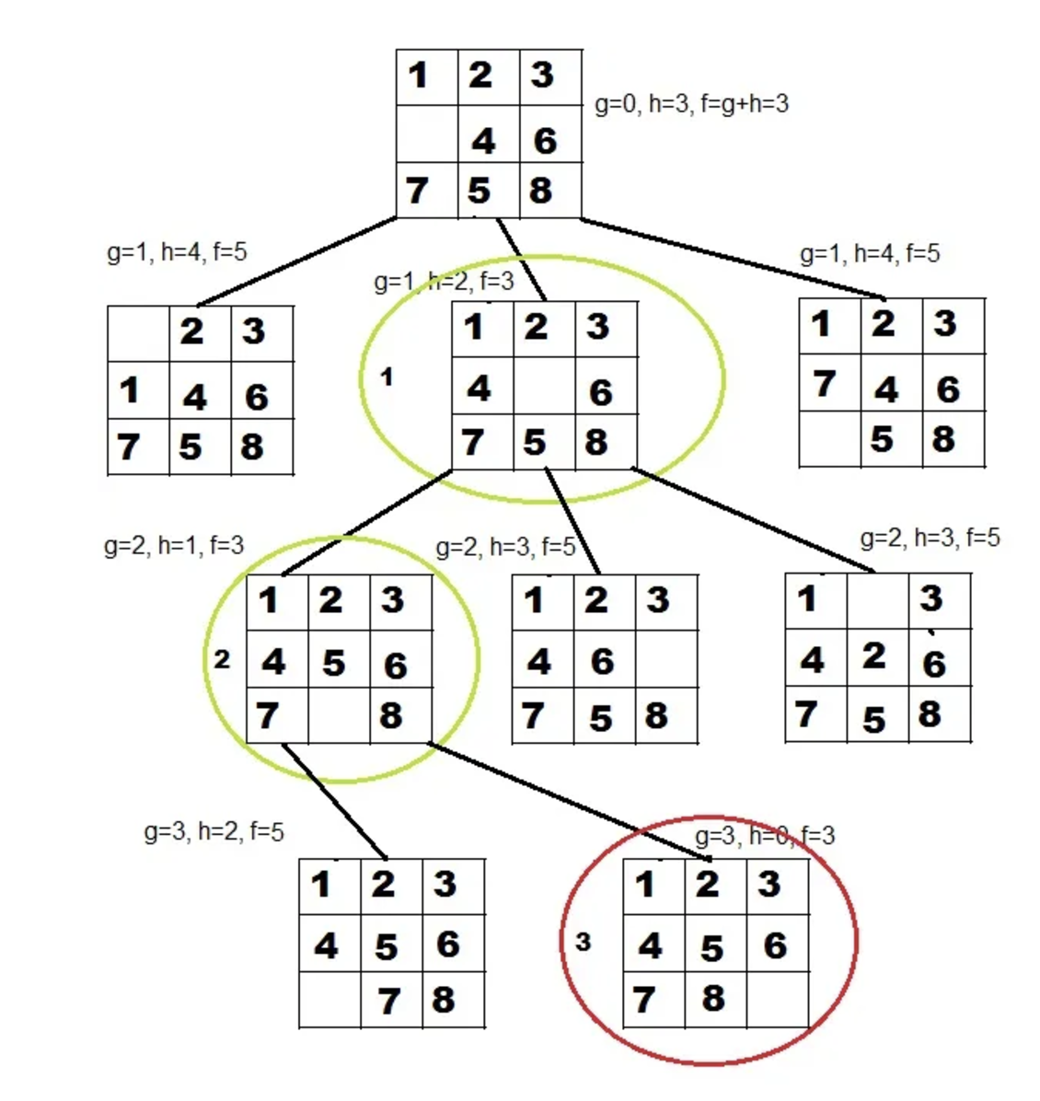
A* in Action: Solving the 8-Puzzle
Start at the initial configuration.
Calculate total cost for each move:
f(n) = g(n) + h(n)
Where,
g(n): Cost from start to current state.
h(n): Heuristic estimate to the goal.
Prioritize states with the lowest f(n).
Expand nodes until the goal state is reached.

Slide 13
Which Algorithm outperforms the other and when?
BFS:
Outperforms A* in very small search spaces or when no heuristic is available.
Its exhaustive nature ensures all possibilities are explored, but it becomes infeasible for large problems.
A* (Manhattan Heuristics):
Outperforms BFS in speed and memory usage for the 8-puzzle due to its efficient heuristic.
Focuses on promising states, reducing unnecessary expansions.

Slide 14
Evaluation Metrics:
Solution Path Length: To measure the optimality of the solution (provided by BFS & A*) and check whether both provide the shortest length.
Nodes Expanded: To measure which algorithm will expand fewer nodes to know the algorithm efficiency.
Maximum Frontier Size: To measure how many nodes are stored in memory at any time to know the use of memory by each algorithm.
Execution Time: To measure the time taken to get the solution to know the feasibility of algorithm in real-world.

Slide 15
